Slide 1
The Effect of Academically Homogeneous Classrooms in Undergraduate Statistics Education
MAJ Jim Pleuss
United States Military Academy
Department of Mathematical Sciences

Slide 2
Methodology
Course Structure (Introduction to Probability and Statistics)
411 Students (mostly sophomores)
37 Unique Sections (~17 students per class)
13 Different Instructors
Course-Wide Exams and a Final
Experiment Structure
Treatment
190 Students (18 sections).
Homogenous sectioning based on past academic performance.
Control
221 Students (19 sections)
Heterogeneous mixture based on random distribution.
Metric:
Compare Performance on
Course-wide Graded Events
Control
221 Students (19 sections)
Heterogeneous mixture based on random distribution.
Compare Performance on
Course-wide Graded Events

Slide 3
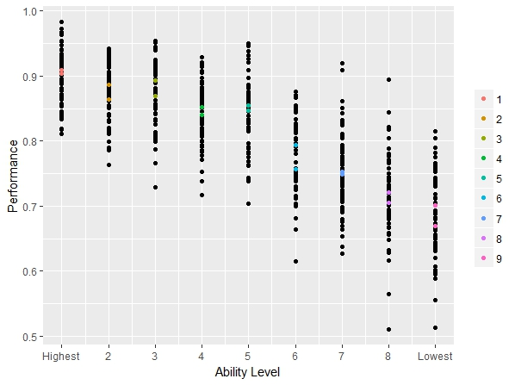
Model Predictive Ability
Actual Performance of All Students Organized by Ability

Slide 4
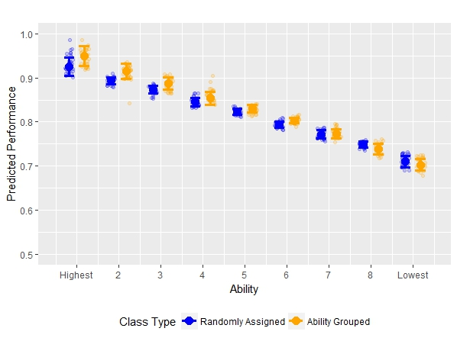
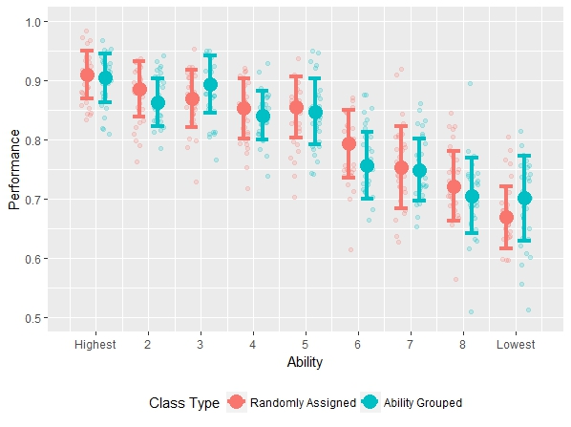
Predicted vs. Actual Results
Actual Performance of Treatment and Control Based on Ability
Predicted Performance of Treatment and Control Based on Ability

Slide 5
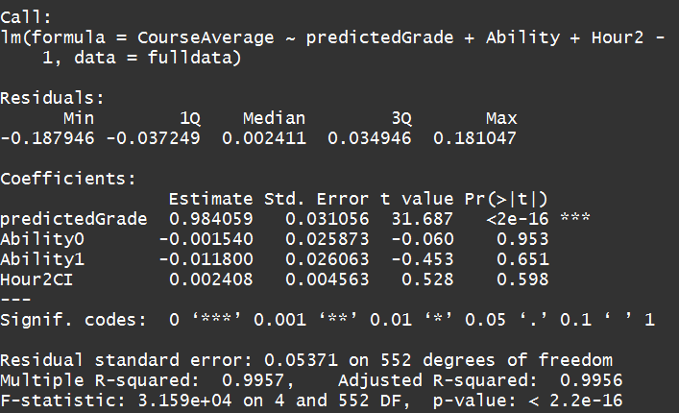
Significance?

Slide 6
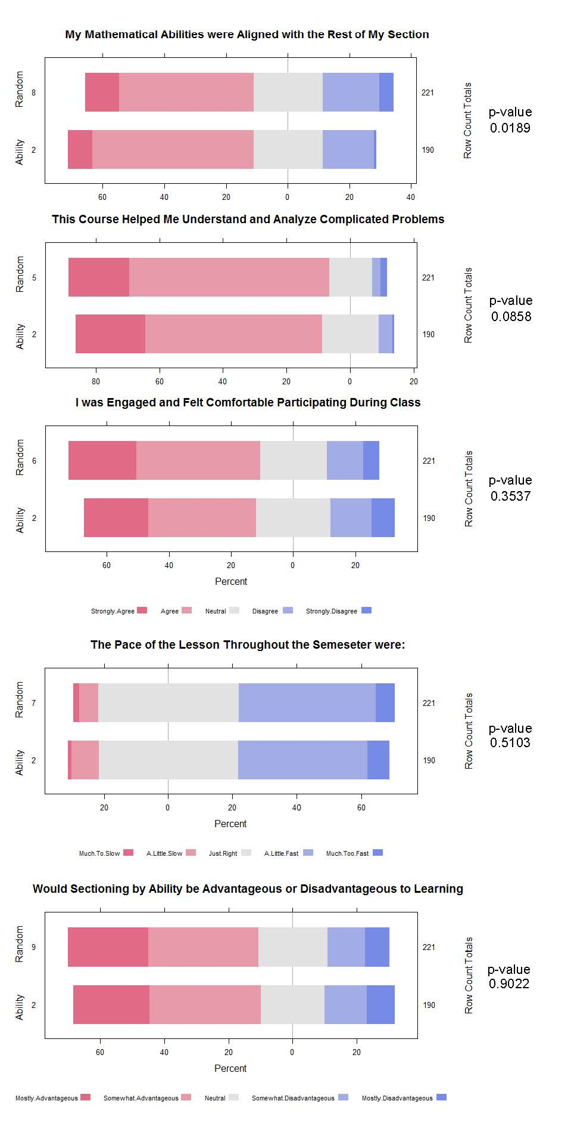
Student Survey Results

Slide 7
Conclusions
Learning Statistics is very different from other core math courses.
Grouping undergraduate students by mathematical ability does not improve their statistical learning comprehension.
Students and Faculty alike believe sectioning by ability improves student learning.

Slide 8

Contact Information
MAJ Jim Pleuss
United States Military Academy
Department of Mathematical Sciences
Email: james.pleuss@usma.edu
Phone: 845-938-5609

